Slide 1
Objective
To achieve Automatic identification of bird sounds without physical intervention.
To spread awareness about importance of bird ecosystem.
To assist ornithologists in identifying bird species.

Slide 2
Motivation
Accurate bird identification is critical for avian biodiversity conservation on a large scale.
It is critical for bird watchers, conservation organizations, park rangers, ecology consultants, and ornithologists all over the world because bird species plays vital role in environment.

Slide 3
Problem Statement
Automated Bird Species identification using audio Signal Processing and Neural Networks.

Slide 4
Literature Survey
Sr.No. | Paper Name | Discription | Problems Founds
1. | Automated Bird Species Identification using Audio Signal Processing and Neural Networks | In this paper, an automatic bird species recognition system has been developed and methods for their identification has been investigated. Automatic identification of bird sounds without physical intervention has been a formidable and onerous endeavor for significant research on the taxonomy and various other sub fields of ornithology. | We also decided to build a dataset encompassing 100 samples of human voice clips and surrounding environmental ambient noise, which were sourced from Google Audio-set and LibriSpeech ASR Corpus datasets
2. | Bird Sound Identification based on Artificial Neural Network | Due to effect of climate changes and count of endangered animal, many researchers proposed animal species recognition system to help them for specific study. This paper proposes to identify bird sound identification using Artificial Neural Network (ANN). Each bird has a different tone of sounds | The recognition algorithm involves of feature extraction using wavelet decomposition and recognition using supervised or unsupervised classifier

Slide 5
Hardware
System Processors : Core2Duo
Speed : 2.4 GHz
Hard Disk : 150 GB
Software
Operating system : 64 bit Windows 10.
Coding Language : Python
Design constraints (IDE) : Spyder.
Database : SQLite

Slide 6
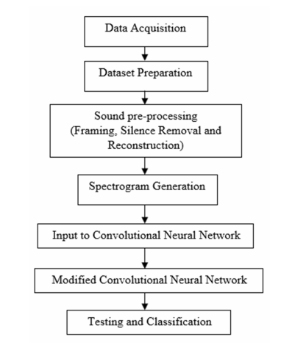
Block Diagram

Slide 7
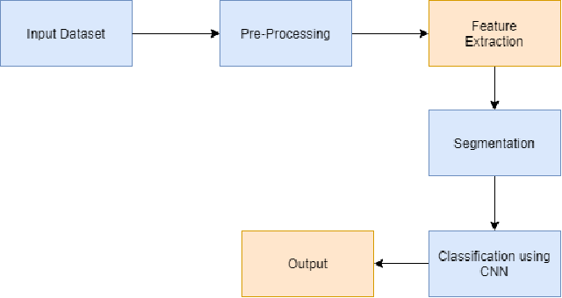
System Architecture

Slide 8
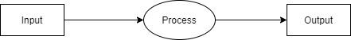
DFD0
Bird Voice
Bird species

Slide 9
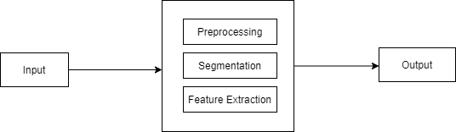
DFD1
Bird Voice
Bird species

Slide 10
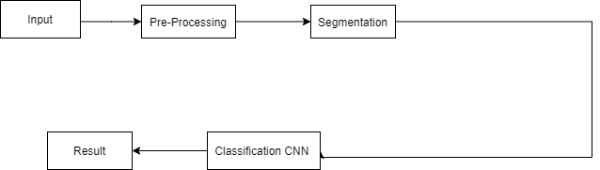
DFD2
Bird sound
Noise removed
sound
Sound segments
Bird Species

Slide 11
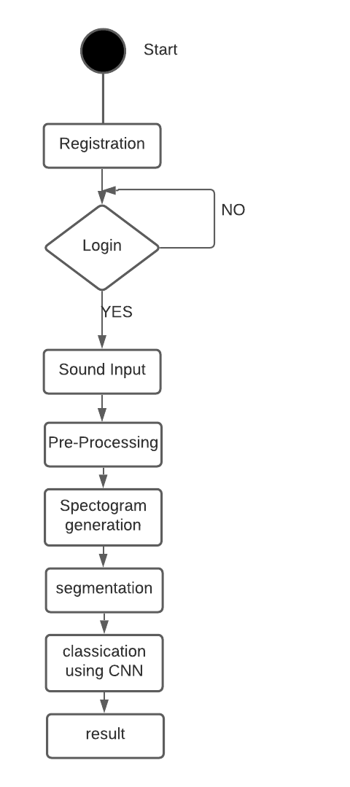
Activity diagram :

Slide 12
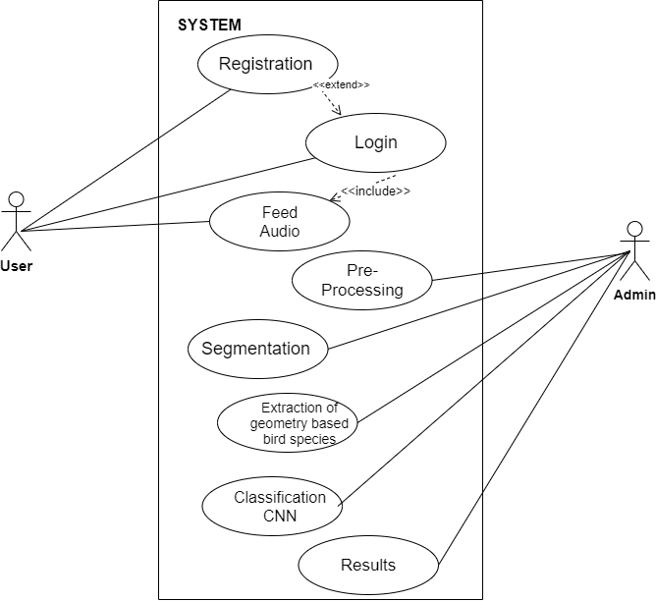
Use case Diagram
System
Admin

Slide 13
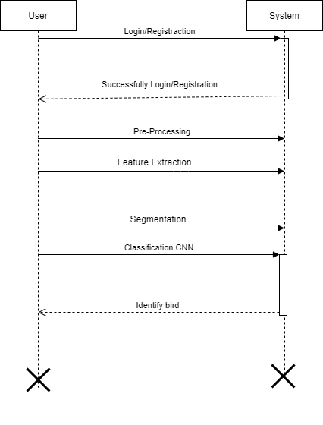
Sequence Diagram

Slide 14
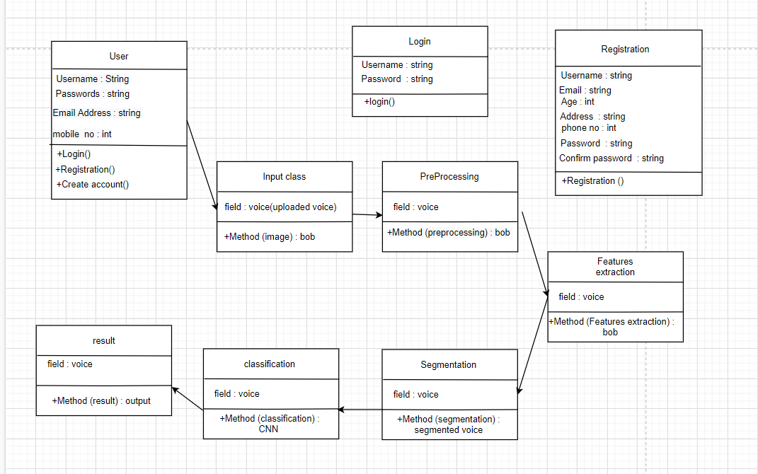
Class Diagram

Slide 15
Algorithm
CNN:
A Convolutional Neural Network (ConvNet/CNN) is a Deep Learning algorithm which can take in an input image, assign importance (learnable weights and biases) to various aspects/objects in the image and be able to differentiate one from the other.
Input image (starting point)
Convolutional layer (convolution operation)
Pooling layer (pooling)
Input layer for the artificial neural network (flattening)

Slide 16
CNN:
1.Build a small convolutional neural network
2.Select Audio to train the convolutional neural network.
3.Extraction of feature filters/feature maps.
4.Implementation of the convolutional layer.
5.Apply the ReLu (Activation function) on the convolutional layer
6.Then apply max pooling on convolutional layers.
7.Next Flatten, This layer used for convert 2D matrix into 1D array.
8.Make a fully connected layer
9.Then input an Audio into CNN to predict the Audio content
10.CNN prediction will be shown.

Slide 17
Libraries
LIBROSA - Librosa is a python library that has almost every utility you are going to need while working on audio data. This rich library comes up with a large number of different functionalities.
TensorFlow - TensorFlow provides a collection of workflows to develop and train models using Python.
Keras - Python library for developing and evaluating deep learning models.
OpenCV, Numpy, Pandas, Matplotlib, etc.

Slide 18
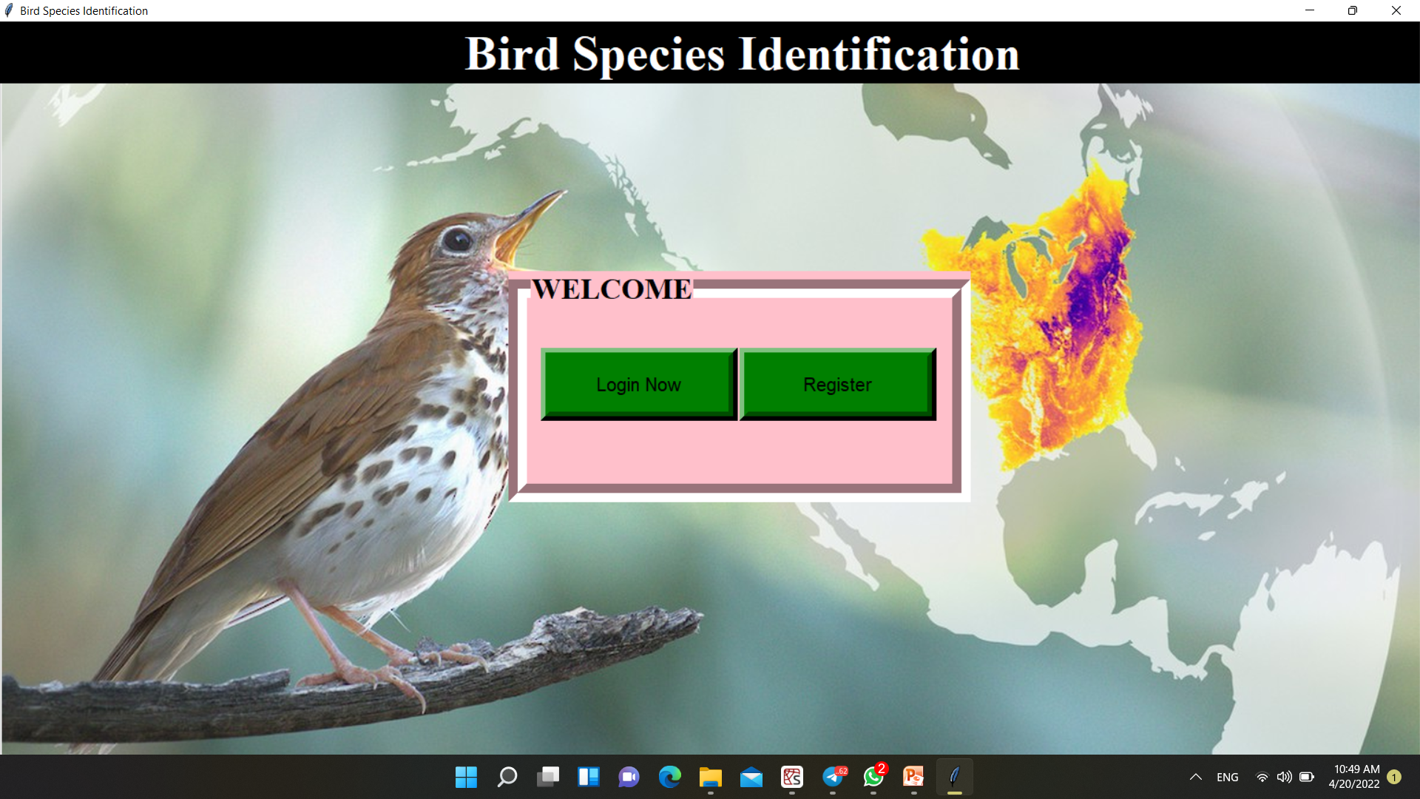
Home Page

Slide 19
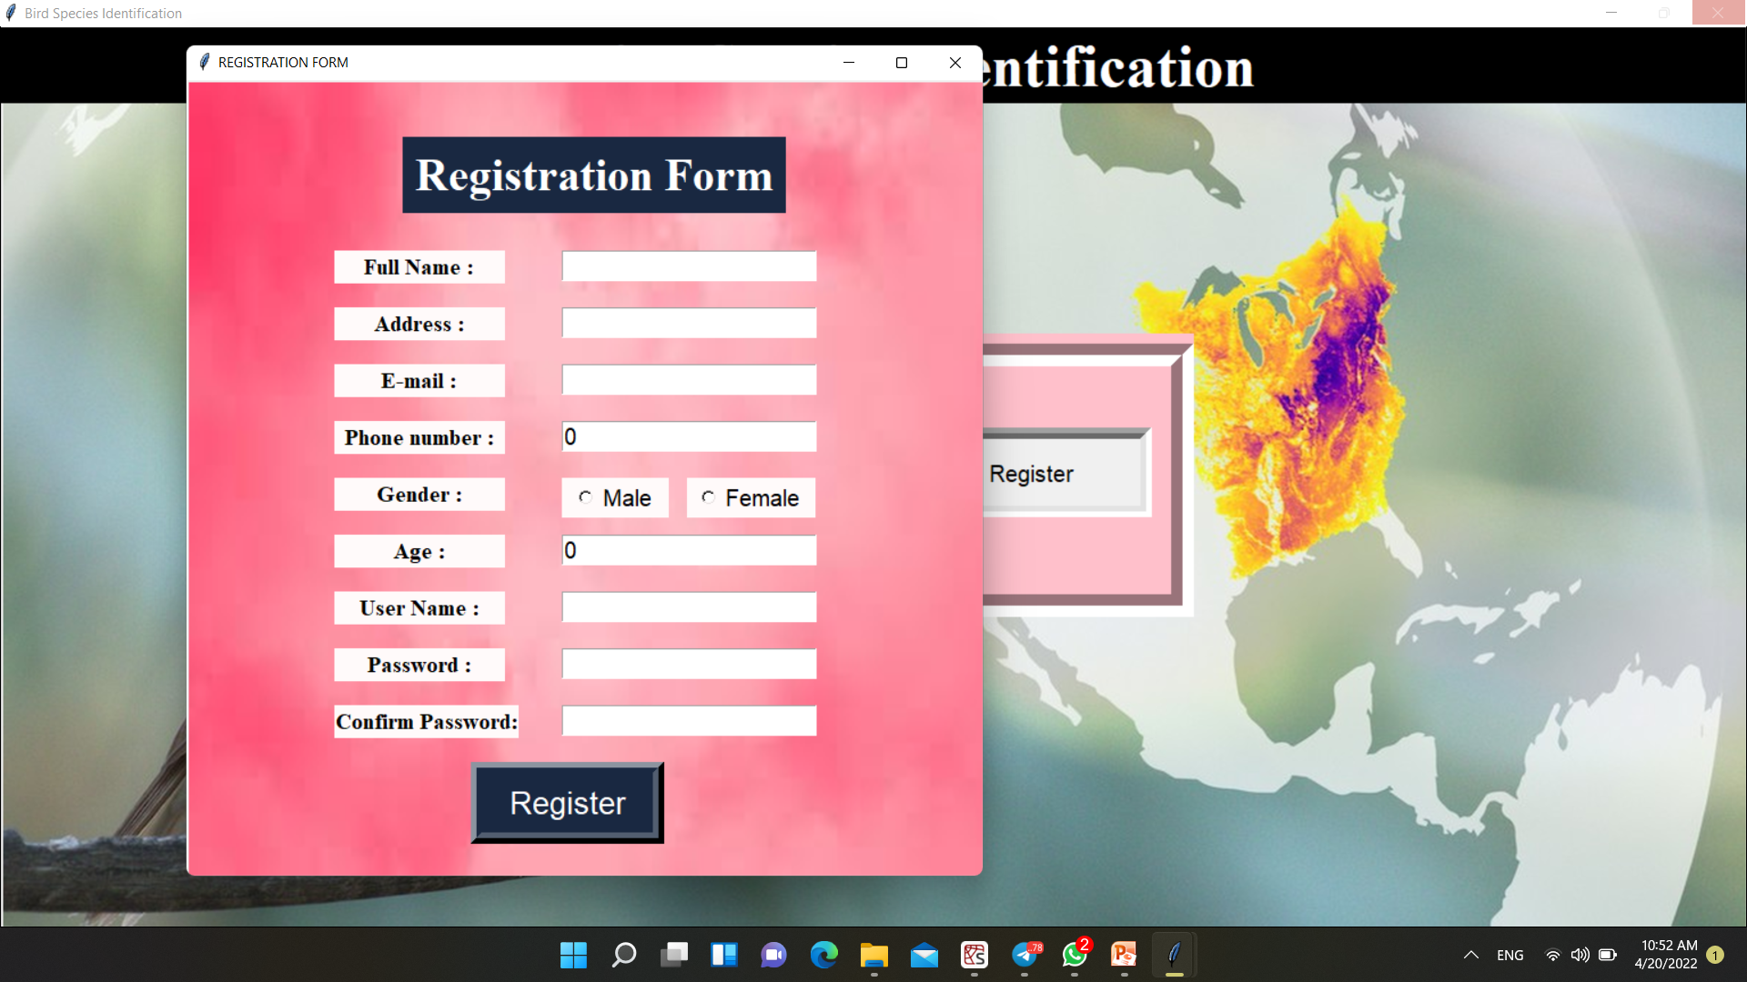
Registration Page

Slide 20
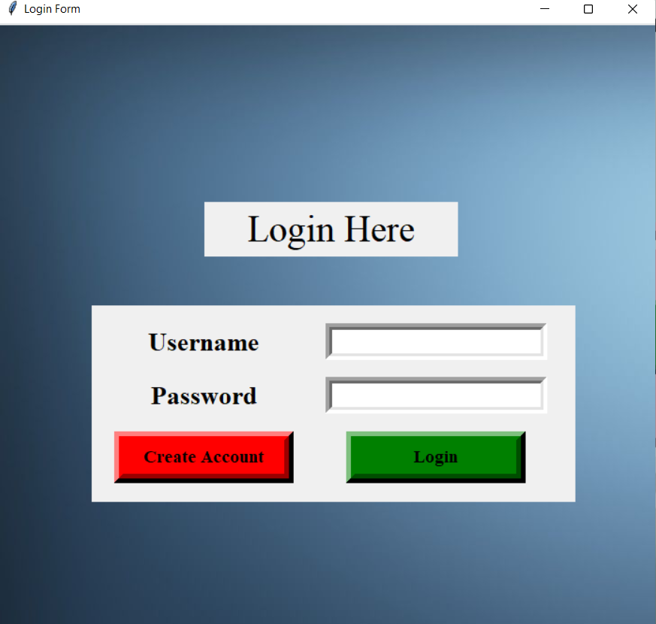
Login Page

Slide 21
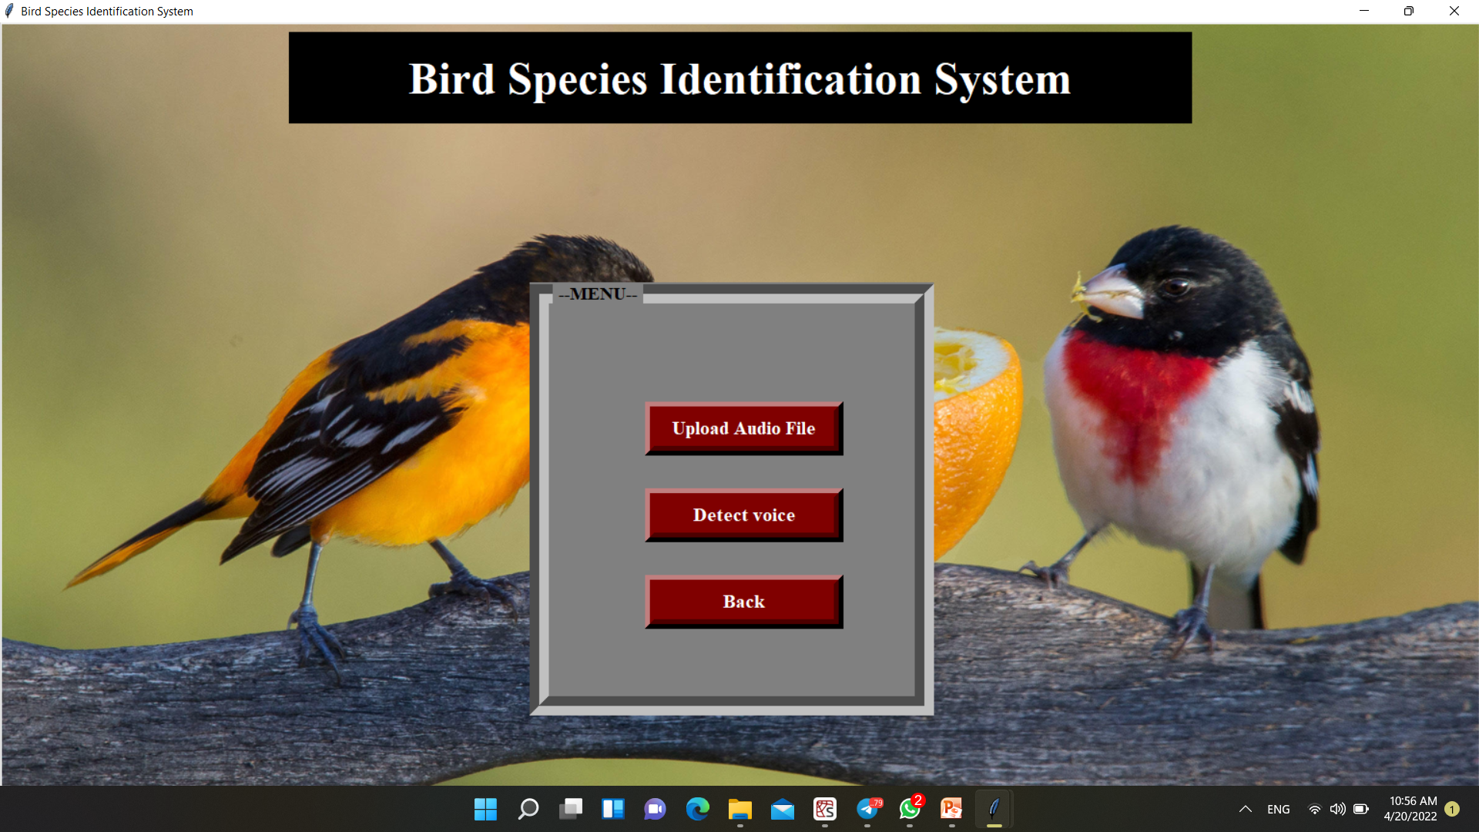
Main page

Slide 22
Project Test Case:
Testing is an investigation conducted to provide stakeholders with information about the quality of the product or service under test. Software testing also provides an objective, independent view of the software to allow the business to appreciate and understand the risks of software implementation.
To test this application we are going with proper sequencing of testing like GUI, unit, integration, validation, Low level and High level test cases, major scenarios likewise.
We will go with the GUI testing first and then integration testing.

Slide 23
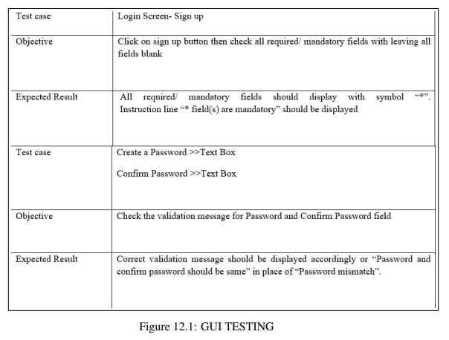
Test Result

Slide 24
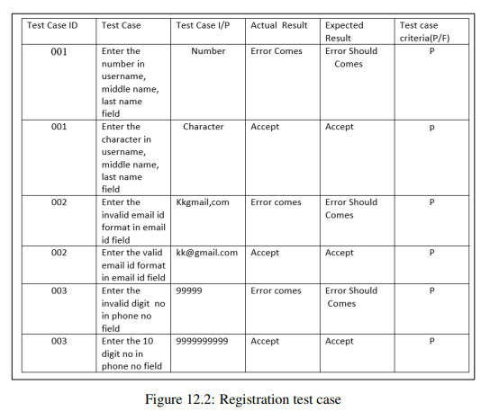
Test Result

Slide 25
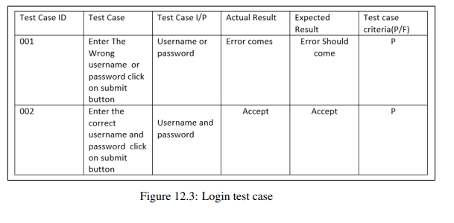
Test Result

Slide 26

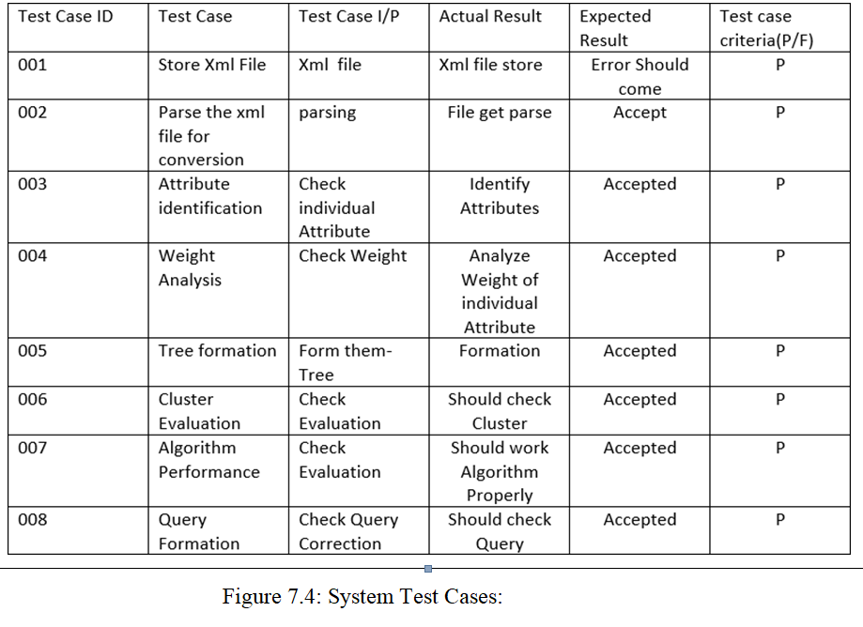
audio

Slide 27
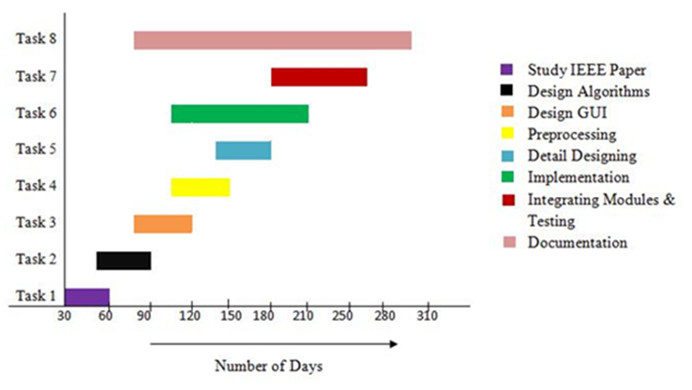
Project Plan

Slide 28
Use
Birds play an important role in a wide variety of ecosystems as both predator and prey, in controlling insect populations, pollinating and seed dispersal for many plants, and in releasing nutrients on to land and sea in the form of guano.
From a scientific perspective it is therefore crucial to monitor bird populations. Now, research could pave the way to an automated bird identification system based on bird calls and song.

Slide 29
Scope
This model helps building applications that helps tourist who go onto bird sanctuaries identify the bird species.
An application can be designed and deployed for mobile devices, which would enable users to use their smartphones as handheld devices for prediction and analysis of bird sounds.
setups can be installed in ecological parks, conservation parks and bird sanctuaries. The data obtained can either be stored locally or on the cloud. The data thus obtained will be of huge significance in studies relating to bird migration patterns, population distribution, biodiversity and bird demographics in a given area.

Slide 30
Conclusion
The system is able to identify bird species from their sounds clips using Convolutional Neural Network (CNN) and successfully recognizes the bird species.

Slide 31
References
[1] www.iucn.org/theme/species/our-work/birds
[2] www.xeno-canto.org/
[3] Sujoy Debnath, Partha Protim Roy , Amin Ahsan Ali, M Ashraful Amin” Identification of Bird Species from Their Singing”, 5th International Conference on Informatics, Electronics and Vision (ICIEV), 2016
[4] Rong Sun, Yihenew Wondie Marye, Hua-An-Zhao “FFT Based Automatic Species Identification Improvement with 4- layer Neural Network”, 2013 13th International Symposium on Communications and Information Technologies (ISCIT)
[5] www.mathworks.com/help/deeplearning/ref/alexnet.html

